Slide 1
Chapter 4
The Laws of Motion
The First Law of Motion

Slide 2
The First Law of Motion
Let’s review…
How do you know when an object is in motion?
What is a force and how does it impact a motion?
So what happens when we combine these two ideas?
You get the Laws of Motion

Slide 3
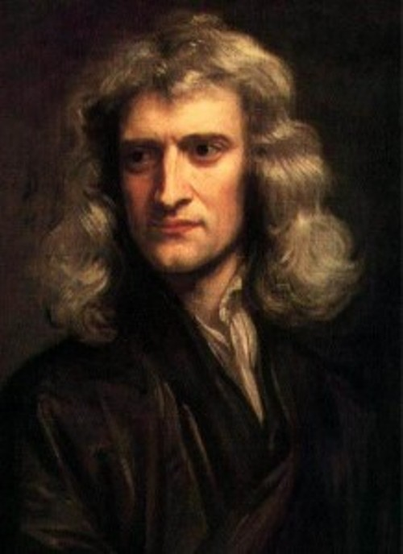
The First Law of Motion
British scientist Isaac Newton realized that the concepts of motion and forces are directly related
He published 3 rules called the Laws of Motion that apply to the motion of all objects we encounter every day, as well as the motion of the planets, stars, and galaxies

Slide 4
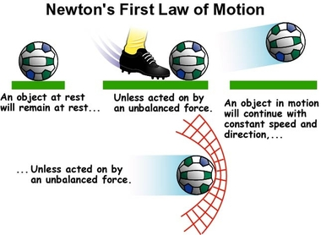
The First Law of Motion
Newton’s First Law of motion describes how an object moves when the net force acting on it is zero
This law says that if the net force acting on an object is zero, the object remains at rest, or if the object is moving, it continues moving in a straight line at constant speed
In other words, an object at rest, stays at rest. An object in motion stays in motion unless some other force acts on it
If the forces acting on an object are balanced, then the velocity of an object doesn’t change

Slide 5
The First Law of Motion
Only unbalanced forces change velocity
Think about pushing a skateboard
When you push it, it will increase in velocity because of the unbalanced force
But it starts to slow down…why?
Friction! So the forces are unbalanced

Slide 6
The First Law of Motion
What happens when an object in motion doesn’t want to change its motion?
We call that inertia
Inertia is the tendency of an object to resist a change in its motion
Inertia depends on the object’s mass
The greater the mass, the greater the inertia
What would be easier to stop it from moving: a volleyball or a bowling ball?
Why?

Slide 7
The First Law of Motion
Inertia and the First Law of Motion
If you observe a change in an object’s velocity, you known an unbalanced force is working on it, which is similar to the definition of inertia (an object resists change of motion)
This is why the first law is also sometimes known as the Law of Inertia

Slide 8
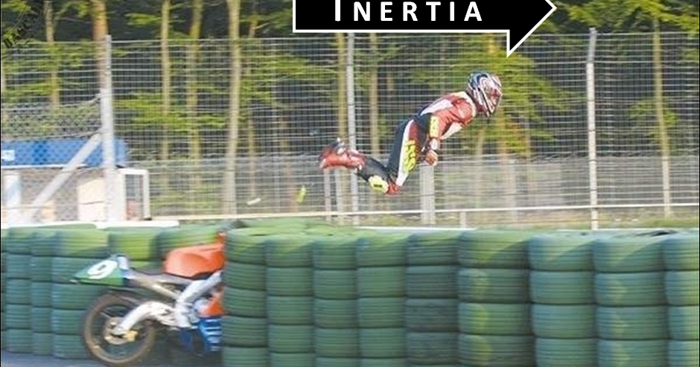
The First Law of Motion
Explain how the first law of motion applies to this picture

Slide 9
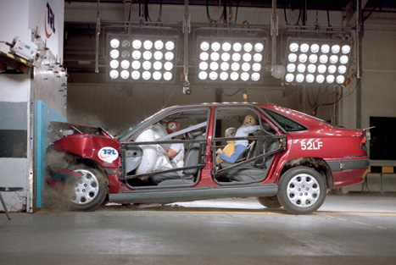
The First Law of Motion
The first law explains what happens in a car crash and why seat belts are so important
If a car is traveling at 50 km/hr and hits something solid, the car will crumple, slow down, and stop in about .1 s
Because of inertia, anyone not wearing a seatbelt continue moving forward at the same speed as the car
Seat belts work in several ways
They reduce the force of the crash acting on the people wearing them by loosening slightly but still restraining the person
This increases the amount of time needed to stop, which reduces the force exerted on the person

